Slide 1

Application: QR Yummy Type: Application Architecture View: Logical View Style: Layered Architecture Pattern
Users
Deliver Channels
Core Business Processes
Data And Information
Technology Enablers
User Account
Connection for Database AWS RDS (MySQL)
Website
Customer’s data
Order Food
Customers and Management
Payment
Order info
User Interface (React)
Cart
Cart info
Application Hosting Server (AWS Elastic)
Internet
Review
Transactions and payment info
Ads
Github & Delivery Pipeline
Admin
Help Desk
Advertising data

Slide 2
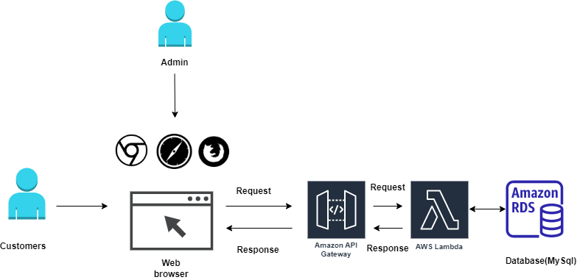
Application: QR Yummy Type: Application Architecture View: Process View Style: Client-Server Pattern

